Slide 1

CSA1452 –Compiler Design for Dynamic Linking-slot A
Guided By, Project By,
D r. S a i r a m. A M. siva sathwik
(Course Faculty) (192211146)
Compiler Design Computer Science & Engineering
SSE, SIMATS SSE, SIMATS

Slide 2
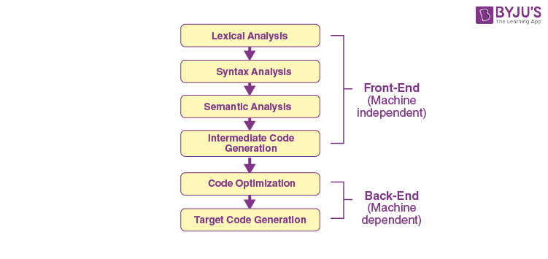
aim
The different phases of compiler design include lexical analysis, syntax analysis, semantic analysis, intermediate code generation, code optimization, and code generation.
Each phase plays a crucial role in the compilation process.
The goal is to produce an executable program that can run on the target hardware.

Slide 3
abstract
The phases of compiler design consist of several steps that transform source code into executable machine code.
These phases include lexical analysis, which breaks the code into tokens.
syntax analysis, which checks the code's grammar and structure.
semantic analysis, which ensures the code's meaning is correct.
code generation, which produces the target machine code.
optimization, which improves the efficiency of the generated code.
Each phase plays a crucial role in the compilation process, ultimately enabling programs to be executed on a computer.

Slide 4
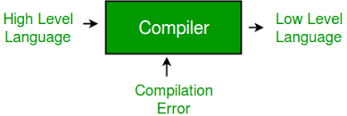
COMPILER
compiler is a sophisticated tool that translates high-level programming language code into machine code or another form of code that can be executed by a computer.
It plays a crucial role in software development by enabling programmers to write code in a human-readable format while producing efficient and reliable executable programs.

Slide 5
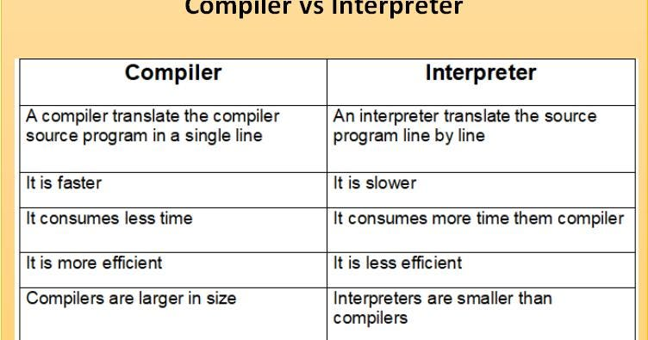
COMPILER VS INTERPRETER

Slide 6
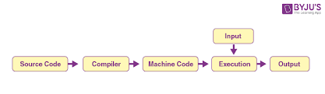
introduction
Analysis of compiler design typically covers the foundational concepts and techniques involved in building compilers.
Compiler design is the process of creating a software system that translates source code written in a high-level programming language into equivalent machine code .
It involves a series of stages aimed at analyzing, transforming, and generating code efficiently.

Slide 7
Literature survey
AUTHOR-1:-
TITLE:-several types of automated tools used in various phases of a compiler design.
YEAR:-2022
AUTH0R 2:-
TITLE:-transformation phase is presented in much detail in the volume Analysis
YEAR:-2013
AUTHOR 3:-
TITLE:-Advanced compiler design implementation.
YEAR:-1997

Slide 8
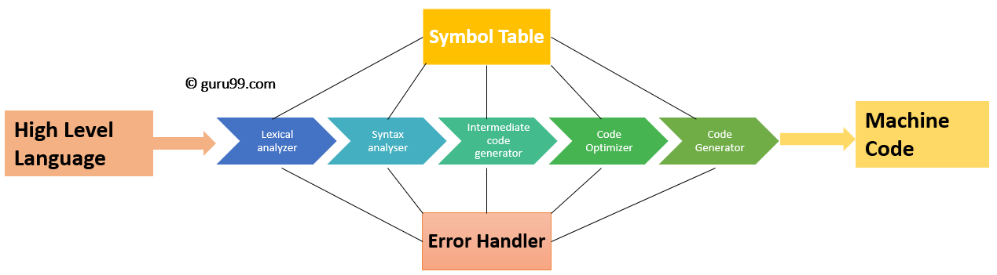
ARCHITECTURE

Slide 9
PHASE 1:-Lexical Analysis (Scanning):
The input to this phase is the source code.
It breaks the source code into a sequence of lexemes or tokens.
Commonly performed by a lexer or scanner.
Discards white spaces and comments.

Slide 10
PHASE 2:-Syntax Analysis (Parsing):
This phase verifies that the tokens produced by the lexical analysis are arranged in a grammatically correct structure according to the language's syntax rules.
Generates a parse tree or abstract syntax tree (AST).
Commonly performed by a parser.

Slide 11
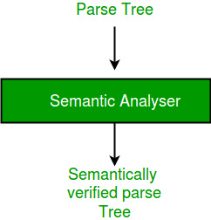
PHASE 3:-Semantic Analysis:
Checks the meaning of the statements in the source code beyond the grammar.
Ensures that the code adheres to the semantic rules of the programming language.
Performs type checking, checks for variable usage errors, etc.
May involve symbol table management.

Slide 12
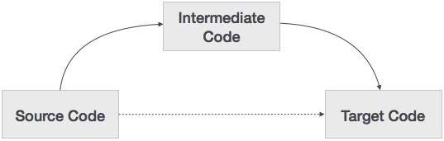
PHASE 4:-Intermediate Code Generation:
Converts the parse tree or AST into an intermediate representation (IR) or intermediate code.
This representation is independent of the source language but easier to translate into the target machine code.
May involve optimizations at this stage (e.g., constant folding, common subexpression elimination).

Slide 13
PHASE 5:-Optimization:
Performs various transformations on the intermediate code to improve the efficiency of the generated code.
Includes optimizations like loop optimization, dead code elimination, register allocation, etc.
Optimization techniques vary widely and can be numerous.

Slide 14
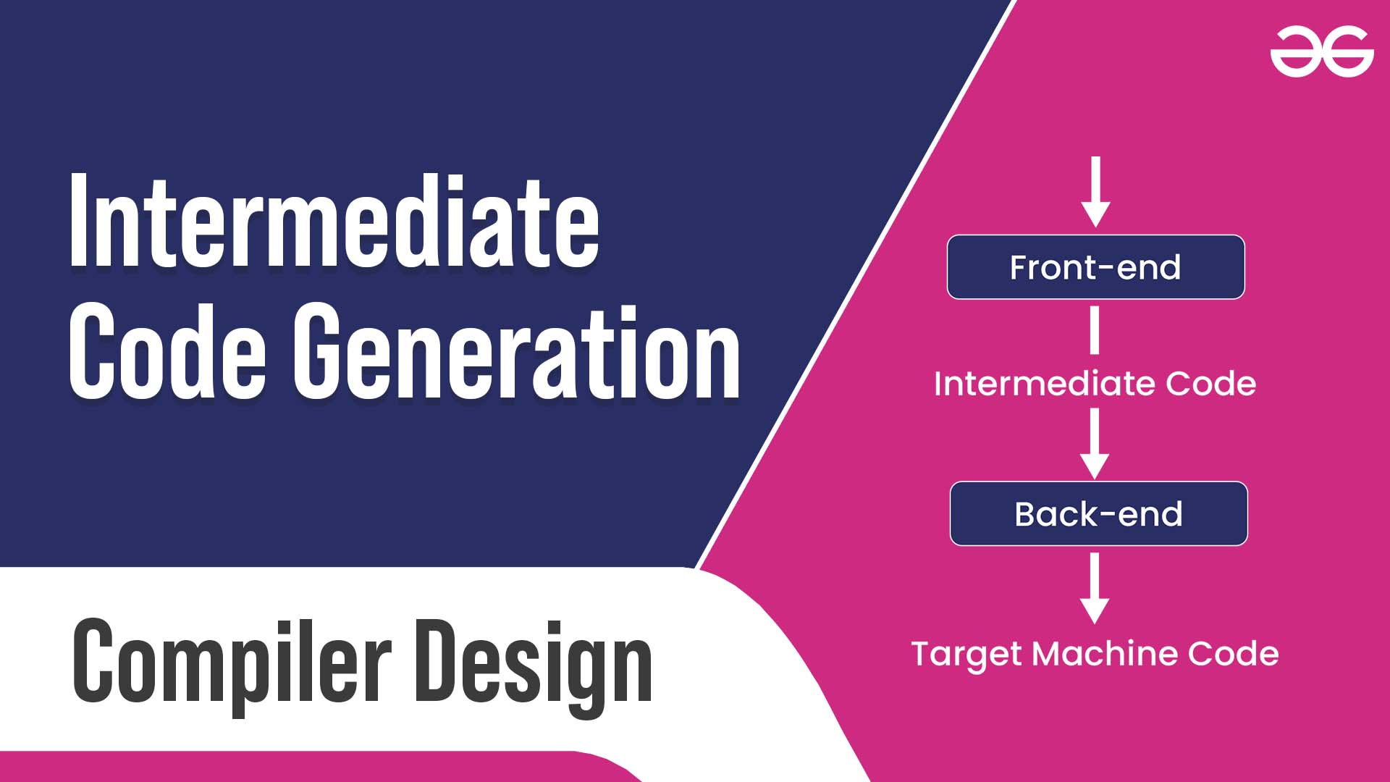
PHASE 6:-Code Generation:
Translates the optimized intermediate code into the target machine code or another language.
May involve instruction selection, scheduling, and other low-level optimizations.
Output can be machine code, assembly code, or another high-level language.

Slide 15
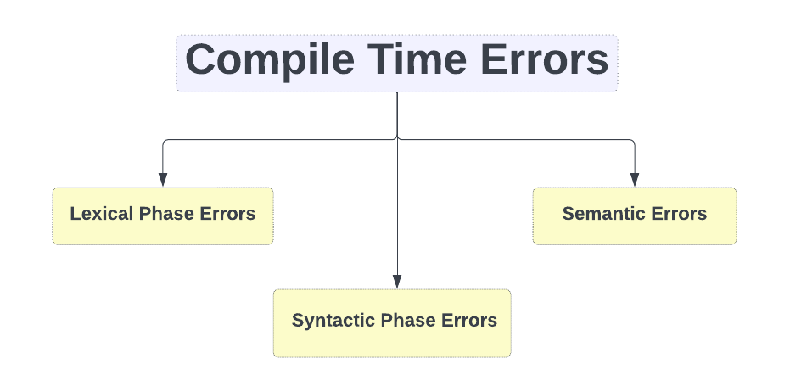
PHASE 7:-Error Handling:
Detects and reports errors found during the compilation process.
Errors can be lexical, syntactical, semantic, or related to code generation.
Provides informative error messages to aid programmers in debugging.

Slide 16
FRONT END AND BACK END
The phases of a compiler are collected into front end and back end.
FRONT END:-
Front-end compilers, also known as front-end tools.
responsible for the initial stages of the compilation process, handling tasks such as lexical analysis, syntax analysis, and semantic analysis.
These components play a crucial role in translating high-level source code into an intermediate representation (IR)
BACK END:-
In the context of compilers, the "back end" refers to the latter stages of the compilation process, specifically focusing on the generation of target code.
the back end of a compiler is responsible for translating the optimized intermediate representation.

Slide 17
result
Analyzing the phases of compiler design involves understanding each phase's purpose, challenges, and how they contribute to the overall goal of translating source code into executable code. the phases of compiler design work together to transform source code into efficient and correct executable code. Each phase plays a crucial role in ensuring that the compiled program

Slide 18
conclusion
The phases of compiler design can vary depending on the context and the specific goals of the compiler. However, in a general sense, the conclusion typically involves the successful transformation of source code into executable code.

